Slide 1
Bio materials
By Dr. Deepali N. Kanekar

Slide 2
Bio materials
Biomaterials play an integral role in medicine today—restoring function and facilitating healing for people after injury or disease.
Biomaterials may be natural or synthetic and are used in medical applications to support, enhance, or replace damaged tissue or a biological function.
The first historical use of biomaterials dates to antiquity, when ancient Egyptians used sutures made from animal sinew.

Slide 3
Metals, ceramics, plastic, glass, and even living cells and tissue all can be used in creating a biomaterial.
They can be reengineered into molded or machined parts, coatings, fibers, films, foams, and fabrics for use in biomedical products and devices like heart valves, hip joint replacements, dental implants, or contact lenses.
They often are biodegradable, and some are bio-absorbable, meaning they are eliminated gradually from the body after fulfilling a function.

Slide 4
Metals and alloys for biomedical applications
METALS AND ALLOY are extensively used as biomaterial for their excellent strength and biocompatibility.
We will discuss about types of metal alloys used as surgical implants.
Research is still continue to develop metallic biomaterials with the highest biocompatibility and least toxicity. M

Slide 5
STAINLESS STEEL
ALLOY of Fe,, Cr, Ni and C.
It has good corrosion resistance due to formation of passive layer on these material (due to Cr).
Used as permanent surgical implant for decades. Eg. 316 L (316 LOW CARBON STEEL)
The biocompatibility in this implants due to protective layer of Chromium oxide.
The advantages of SS are that it is cheap, easily available and has excellent fabrication properties, is biocompatible and has great strength.

Slide 6
Most of internal fixation devices like wires, pin, screws, plates, and intramedullary nails or rods are made up of SS.
Limitation:
Within the body, the SS implants are exposed to rather complex body fluids, which contain chloride ions, reduced sulfur, etc. and when SS reacts with these ions, toxic elements like nickel and chromium are released. (to over counter these alloy can coated with transition metal nitrides eg. TiN, VN, TiAIN)

Slide 7
Another major concern in using SS as a biomedical implant is the presence of nickel, which is toxic, and many patients are nickel sensitive. Research is also going on in developing nickel-free SS. Nitrogen, which is also an austenite stabilizer like nickel, is being used instead of nickel.

Slide 8
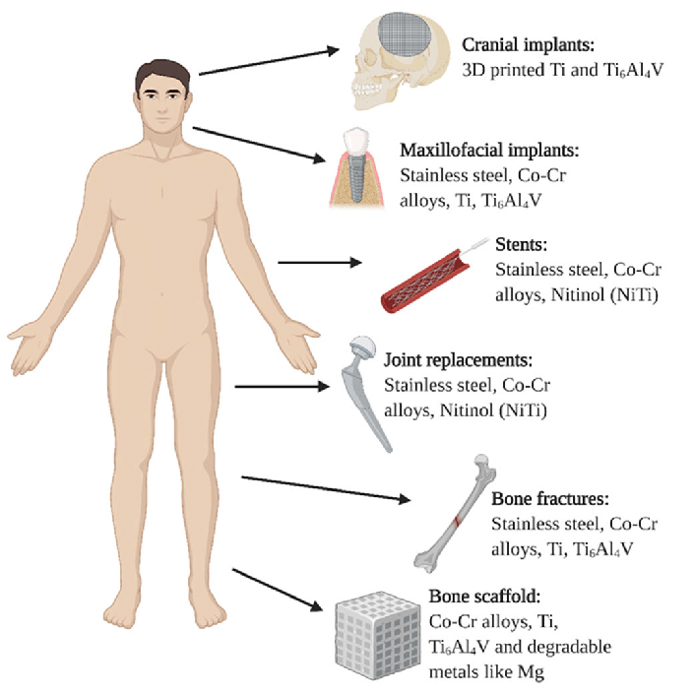

Slide 9
Cobalt- chromium alloys
The alloys are generally combination of cobalt, chromium, and molybdenum, or cobalt, nickel, chromium, and molybdenum.
They are often used as components in modular prosthetic devices such as hip or knee joints, particularly in the ball and socket joint where movement occurs.
Other applications of this alloy include implants like tibial trays, acetabular cups, dental parts, pacemaker lead casings, as well as cardiovascular stents.

Slide 10
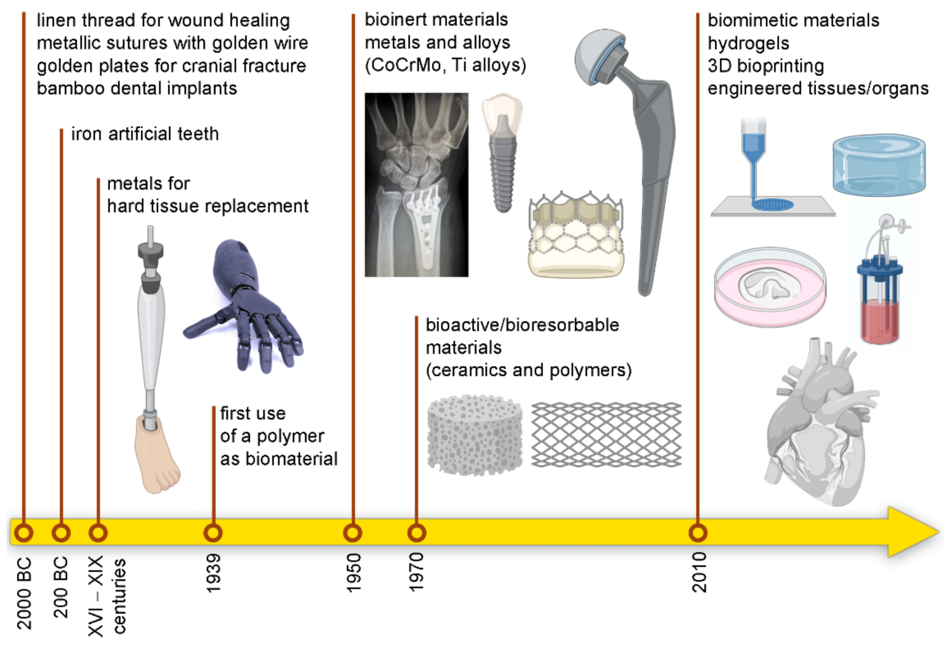

Slide 11
Bio Ceramics

Slide 12
What is Biocermaics?
Ceramics are refractory polycrystalline compounds
Inorganic
Hard and brittle
High compressive strength
Applications
Orthopaedic load-bearing coatings
Dental implants
Bone graft substitutes
Bone cements

Slide 13
Classification of Bio-ceramics
The development of bio-ceramics can be classified into three generations.
The first generation would correspond to bio-inert bio-ceramics, such as alumina and zirconia, which are mostly used for inert orthopedic and dental implants.
The second generation comprises bioactive and bioabsorbable ceramics, such as calcium phosphates or bioglasses.
The third generation is scaffolds for tissue engineering which aim to drive the regeneration of living tissues.
In the meantime, many studies have demonstrated that better and unusual material properties can be achieved by manipulating ceramic length scales in the nano range. For that reason, during the last two decades, nanostructured materials have been widely studied and significant steps forward have been made in their understanding in recent years.

Slide 14
Ceramics are broadly used in a large variety of technological applications requiring both structural and functional properties.
They have received significant attention as candidate materials for use as structural materials under conditions of high loading rates, high temperature, wear and chemical etching too severe for metals.
In this sense, bone-related biomedical applications are the most demanding of bioceramics.
However, their inherent brittleness derived from their low fracture toughness has prevented their use in some applications.
Moreover, the presence of flaws or defects in the material can lead to catastrophic failure during mechanical loading. Therefore, new kinds of materials have been studied for increasing the performance of ceramic matrix materials.
For ceramics used in biomedical applications, which are extensively called bioceramics, this problem still remains.
Nanophased ceramics are being investigated as a way of solving some of the structural and bio-related problems.

Slide 15
For example, nanometric features in the surface of a prosthesis seem to reduce the risk of rejection and enhance the proliferation of osteoblasts (bone-forming cells).
Nanophased or nanostructured ceramics can be obtained either by nanocrystalline materials or with nanocomposites.

Slide 16
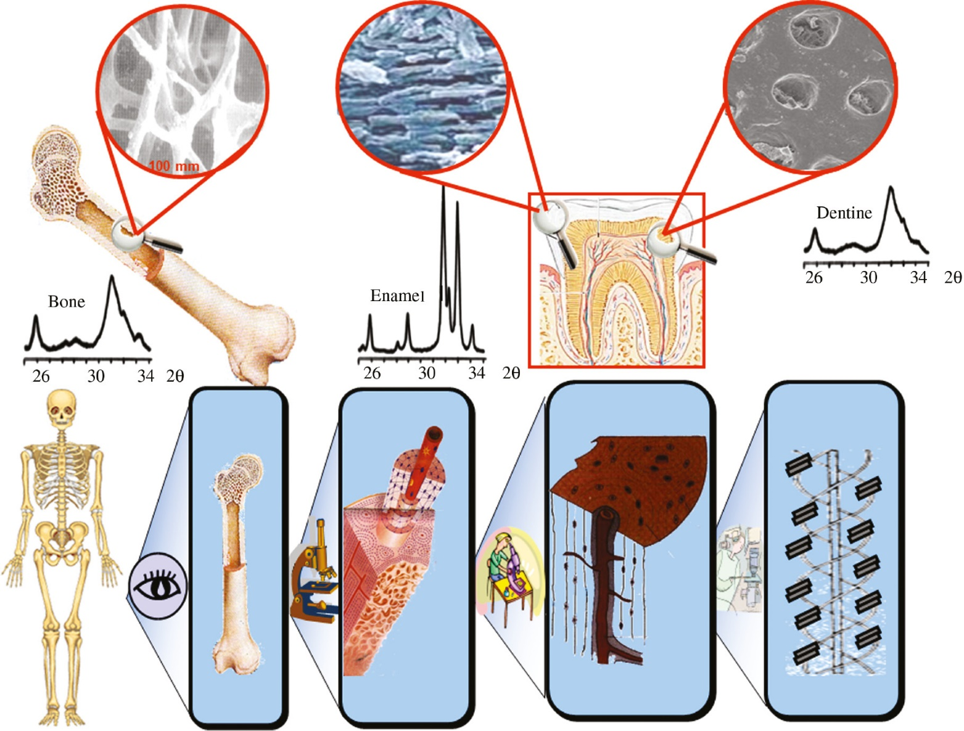
Bioceramics: from bone substitutes to nanoparticles for drug delivery

Slide 17
Properties and Application of nanocrysatlline ceramics
In the case of nanocrystalline ceramics, as the grain size is reduced, the grain volume at grain boundaries is increased (Meyers et al., 2006).
Thus, due to the high density of interfaces, an important fraction of atoms will be at the interface.
This fact allows nanocrystalline materials to offer unusual and improved properties when compared to microscale materials.
There are studies (Webster et al., 1999) that provide evidence that nanophase ceramics could promote osseointegration, which is critical for the clinical success of orthopaedic/dental implants.
Webster et al. (2000) synthesized dense nanophase alumina (Al2O3) materials and showed a significant increase in protein absorption and osteoblast adhesion on the nano-sized ceramic materials compared to traditional micron-sized ceramic materials.
Other studies (Du et al., 1999) have suggested that better osteoconductivity would be achieved if synthetic Hydroxyapatite(Hap) could more resemble bone minerals in composition, size and morphology.
Notes:
Hydroxyapatite (HAp) is most common calcium phosphate ceramic that is used in biomedical applications owing to its chemical composition, which is similar to human bone and teeth. Hydroxyapatite can be synthesised using chemical precursors, especially calcium and phosphorus, using various methods including, dry, wet, thermal, or a combination of these methods. Instead of using chemical synthesis, HAp can also be extracted from natural sources, such as animal bones and scales which are rich in HAp content. Different synthesising methods result in different morphologies, sizes, and phase crystallinities. The concern of achieving a nano-sized HAp has attracted a great deal of attention owing to the human bone HAp is in nano-size range, and the nano size HAp has excellent clinical performance compared to micron-sized HAp. Furthermore, production of nano-size HAp improves cell proliferation and cellular activity in bone growth, which makes it more suitable as biomaterials for bone implants. Thus, various parameters were studied to achieve a composition of HAp that is like the HAp in human bone and teeth.

Slide 18
Advantages
The use of nanocrystalline materials can thus offer advantages for use in biomedical applications, such as:
increased resistance/hardness
improved toughness
lower elastic modulus and lower ductility
reduced risk of rejection
enhanced proliferation of osteoblasts
promotion of ossointegration
With ceramic nanocomposites, even greater improvements can be achieved and the use of new ceramic matrix nanocomposites has been suggested (Gleiter, 1995; Narayan et al., 2004;

Slide 19
Nano-Composites
Ceramic nanocomposites
Nanocomposites based on ceramic materials have been studied in order to improve mechanical properties and alter functional properties.
The ceramic nanocomposites reported until now are either a ceramic nanophase in a ceramic matrix, a carbonaceous nanophase in a ceramic matrix or a ceramic nanophase in a polymer matrix.
Enhancements in stability, hardness, strength, toughness and creep resistance compared to the unreinforced matrix material have been reported in nanocomposites (Narayan et al., 2004).
Moreover, the combination of properties can lead to a new generation of medical devices and implants combining mechanical properties with bioactive properties.

Slide 20
Some examples of ceramic based nanocomposite materials are as follows.
Alumina-based nanocomposites: with the addition of several nano-reinforcements, alumina matrix materials with improved mechanical properties (higher resistance, hardness, wear resistance and fracture toughness) have been obtained.
Alumina/silicon carbide nanocomposites: the incorporation of SiC nanoparticles to an alumina matrix increases wear resistance.
Alumina/zirconia nanocomposites: also known as zirconia-toughened alumina (ZTA) nanocomposites, they consist of a fine-grained alumina matrix reinforced with zirconia particles. The addition of the zirconia nanoparticles is intended to increase the toughness of the alumina matrix.
Alumina/titania nanocomposites: increased hardness, fracture toughness and fracture resistance have been achieved.

Slide 21
Zirconia/alumina nanocomposites: also known as alumina-toughened zirconia (ATZ), they consist of a zirconia matrix reinforced with alumina nanoparticles. They show exceptional resistance and extraordinary toughness.
Silicon nitride/silicon carbide nanocomposites: the obtained results are controversial.
Ceramic/carbon nanofibre composites: widely used, there is an improvement in properties (Pace et al., 2002).
Ceramic/carbon nanotube (CNT) composites: mechanical and electrical properties are enhanced, but biocompatibility issues are still contro- versial (Streicher et al., 2007; Garmendia et al., 2008, 2009, 2010, 2011).
Ceramic in polymer composites: especially relevant for tissue engineering applications.

